Slide 1

COLLEGE BOT
Under the esteemed guidance of
SHAIK.MEER SUBHANIALI
By
R.RAKSHITA GOUD-15E51A0588
N.BHARAT-15E51A0572
MD ALEEMUDDIN-14E51A0555
RAJA SHEKAR-15E51A0589

Slide 2
Objective
The objective of COLLEGE BOT is to minimize the effort of an organisation by giving instant replies to the frequently asked queries about it's institute.
Notes:
7/27/17

Slide 3
Introduction
A COLLEGE BOT is a chat bot for users through which they can ask any queries about a college at a glance . It has a simple user interface. The bot uses predefined answers for frequently asked questions to answer the query.
Notes:
7/27/17

Slide 4
Software and Hardware Requirement
Software:
Python 3.6
Pycharm IDLE
Hardware:
Intel core i3 or greater
Ram:2GB
Windows 7 or greater
Notes:
7/27/17

Slide 5
Block Diagram
Notes:
7/27/17

Slide 6
Design

Slide 7
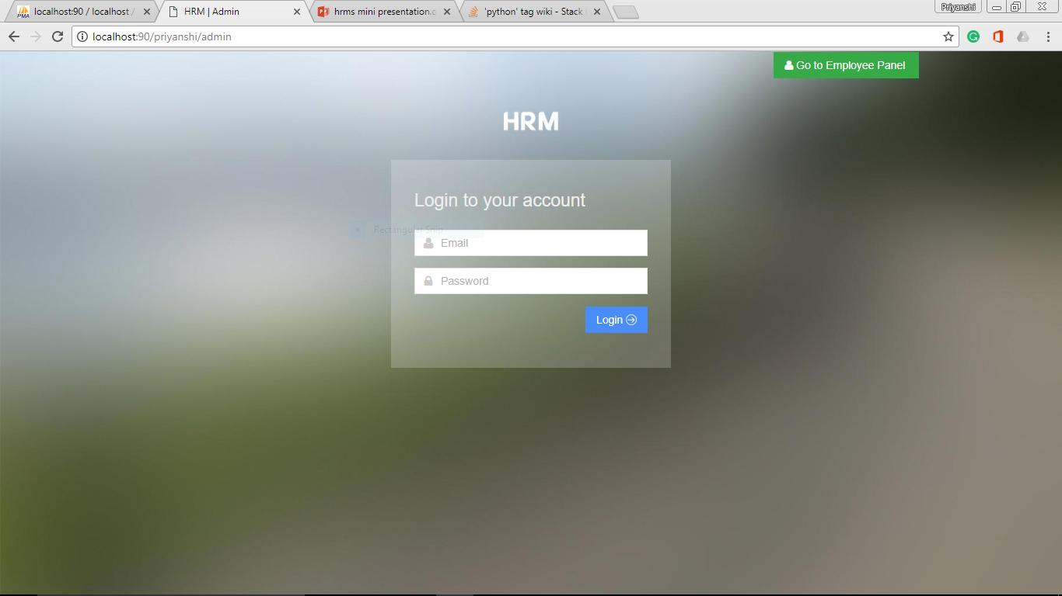
Implementation

Slide 8
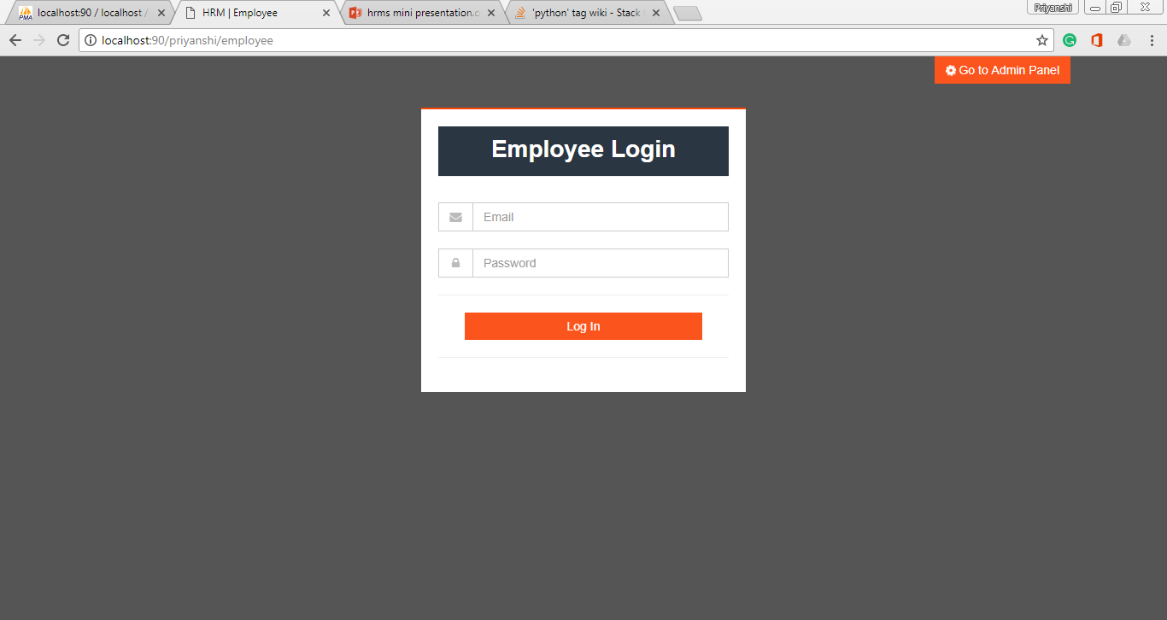
Implementation

Slide 9
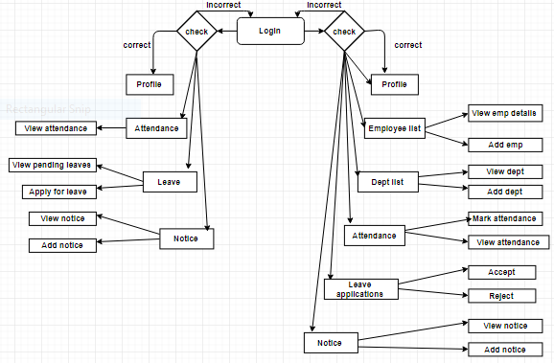
Flowchart

Slide 10
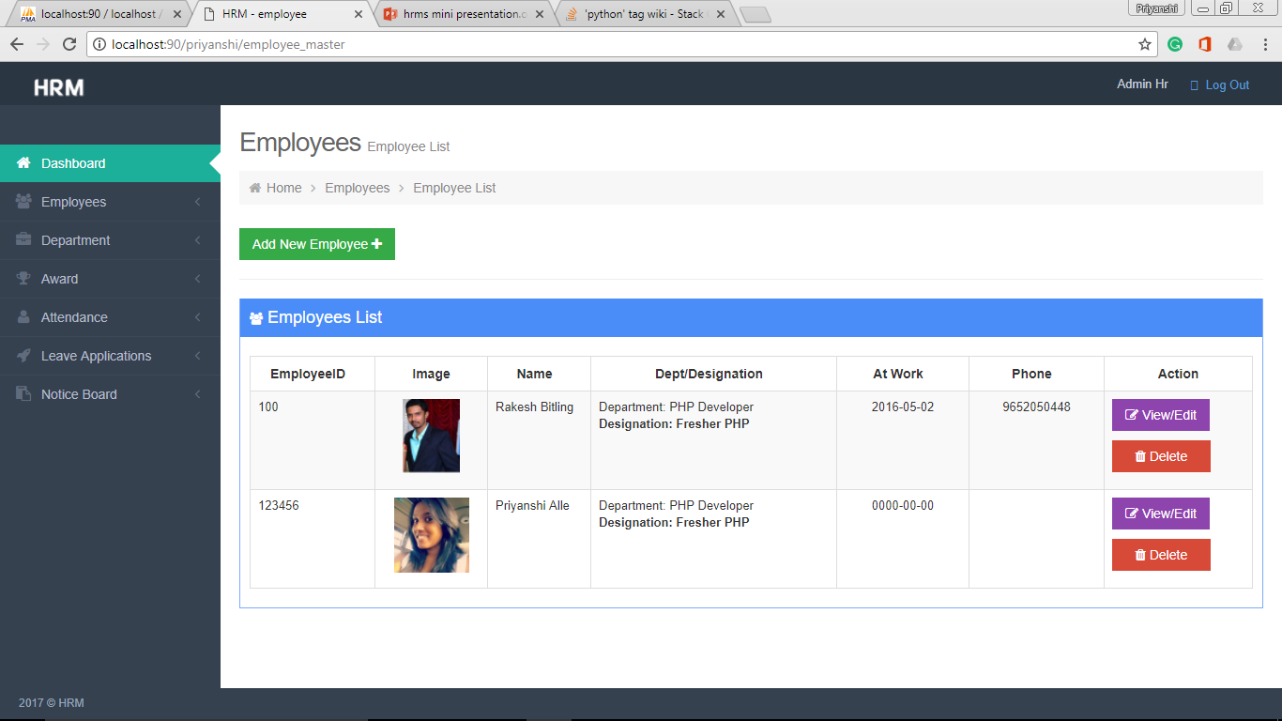
Results

Slide 11
Conclusion
Human resource management system has made it possible for an organization to have an overview of all the employees and their functioning in one go.

Slide 12
Future Scope
Human resources planning
Job analysis design
Recruitment and selection
Orientation and induction
Training and development
Performance appraisal
Compensation planning and remuneration
Motivation, welfare, health and safety
Industrial relations

Slide 13
References
•http://www.hrpayrollsystems.net/hrms/
•https://www.w3schools.com/php/
•https://www.w3schools.com/html/default.asp
•https://www.w3schools.com/css/default.asp
•https://www.w3schools.com/js/default.asp
•https://www.w3schools.com/xml/ajax_intro.asp

Slide 14
Thank You

